Slide 1

Group Project #3
Daniel Knopp, Kenzie Hensel & Ryan Hensel

Slide 2
Our Approach
Created Class for:
- Graph Nodes
- Name, ID
- Neighbors List (with Distances)
- Min Time to Here
- Have Visited?
- Predecessor
Defined Functions For:
- Uncertainty in the routes (road Work)
- rush hour Scaling
- Dijkstra’s Algorithm
- Graph Visualization
- Graph Tabular Output
Executed Code For:
- Baseline Case
- Baseline Case with Uncertainty
- Rush Hour with uncertainty
Notes:
-DAN

Slide 3
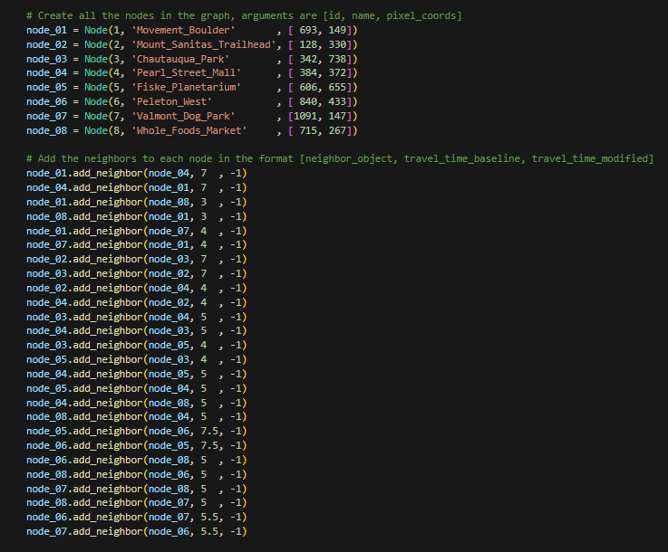
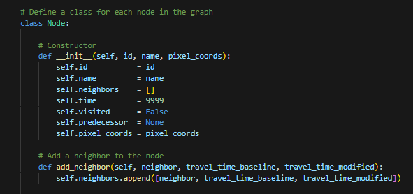
Our Data Structures
Each node has attributes to track:
Name and numerical node ID
Minimum travel time from starting node
Flag for visited status
Neighboring node list
Predecessor node information (previous node along the minimum travel time path)
Pixel coordinates relative to Google Map screenshot
Each element in neighboring node list is itself a list containing:
Neighbor node object
Baseline travel time
Modified travel time (rush hour, uncertainty scaled)

Slide 4
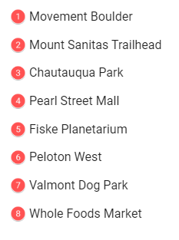
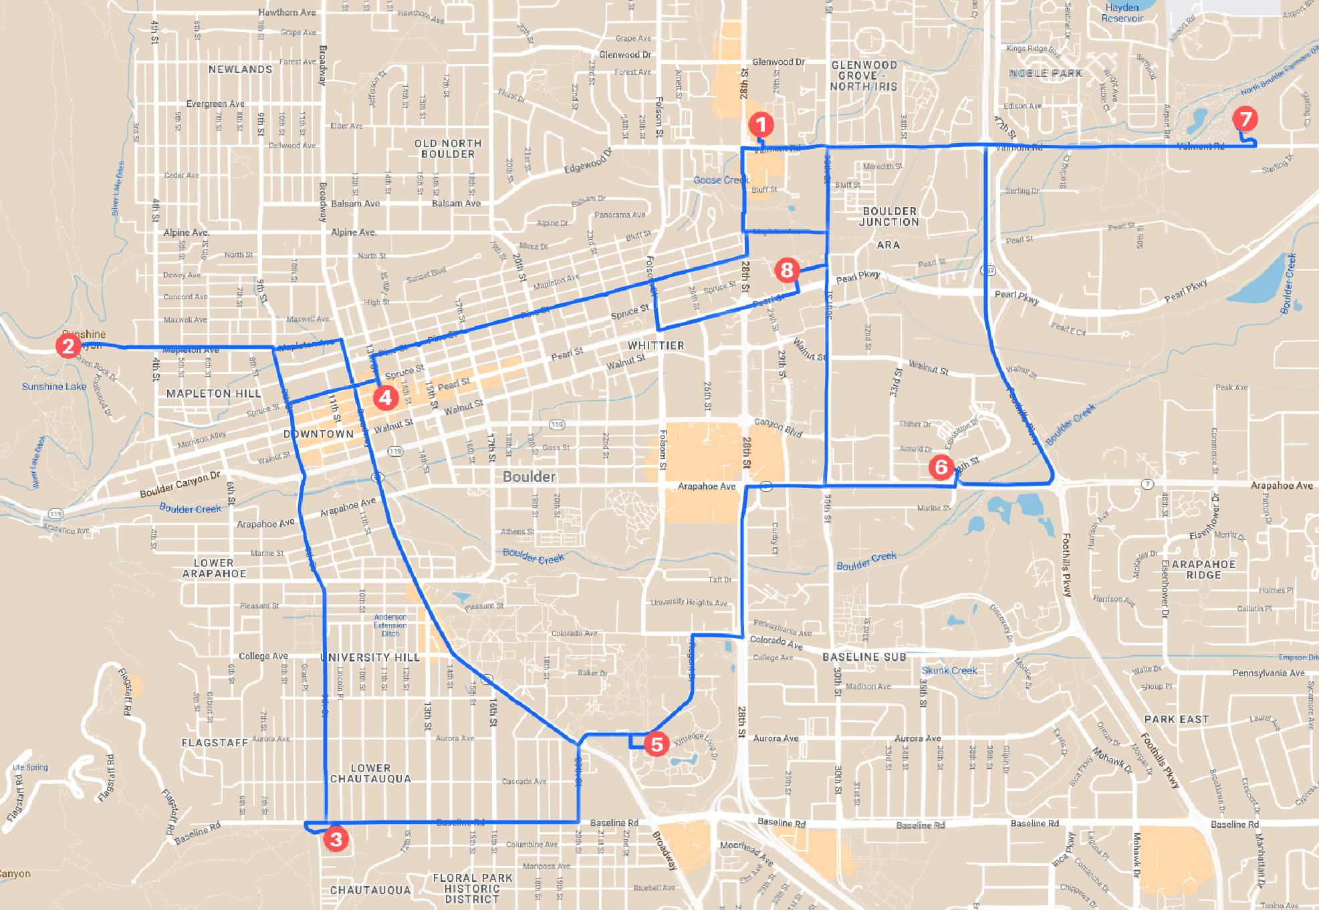
Notes:
-KENZIE
WHAT CITY AND WHY
HOW WE CHOSE SPOTS
MAP OVERLAYS

Slide 5
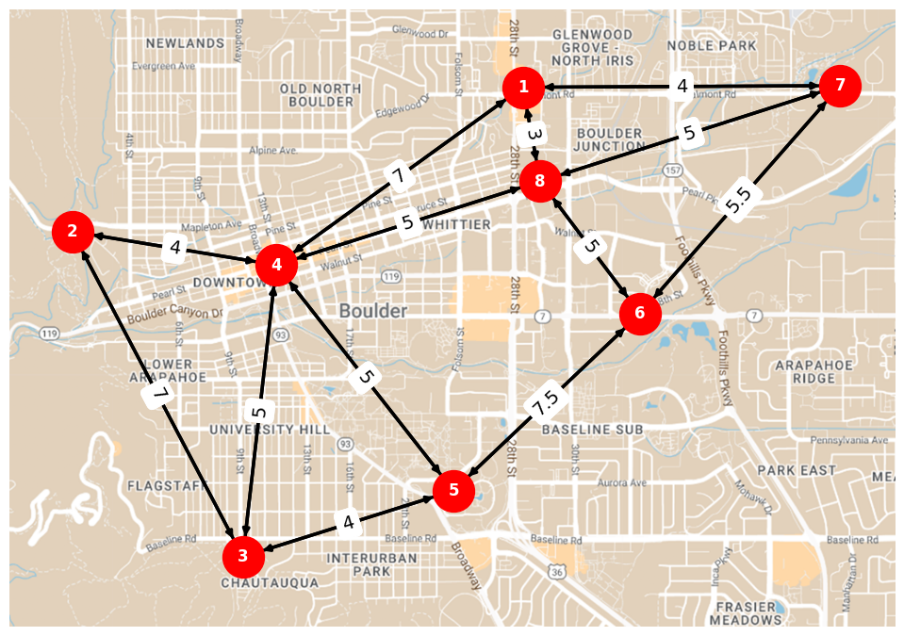
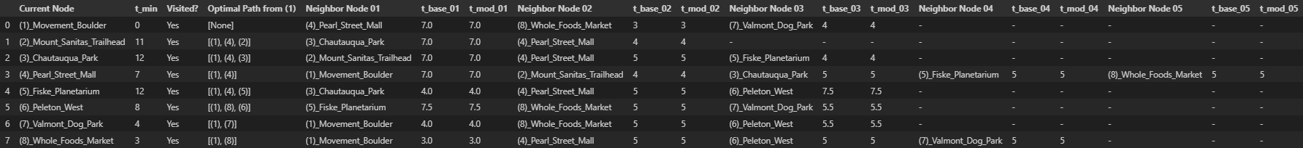
Start
Base Case
Optimal Route from 1 to 3 (12 min)
Path 1, 4, 3
Finish
Notes:
-RYAN

Slide 6
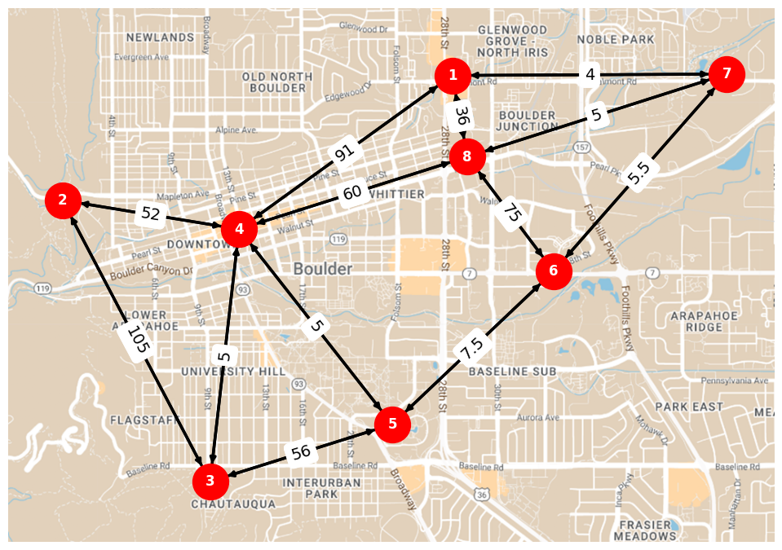
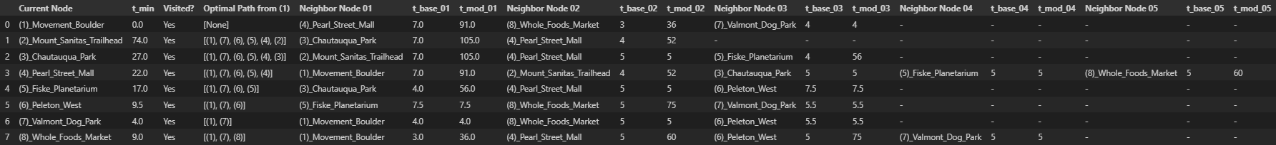
Start
Base Case with Uncertainty
Optimal Route from 1 to 3 has changed (27.0 min)
Path 1, 7, 6, 5, 4, 3
Finish
Notes:
-RYAN

Slide 7
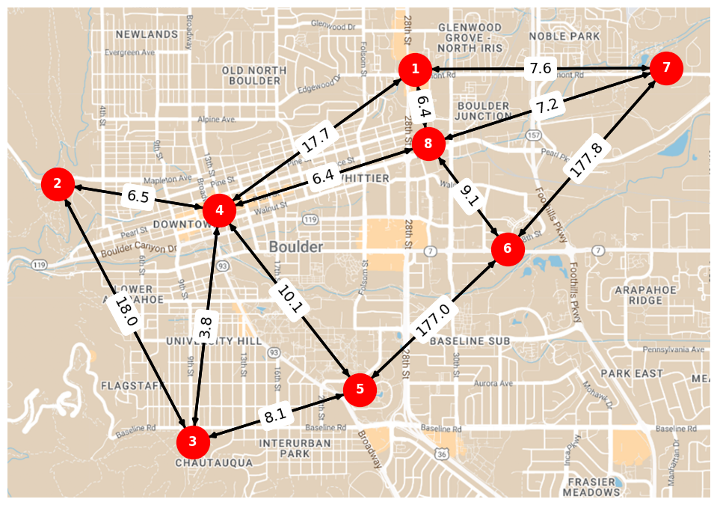
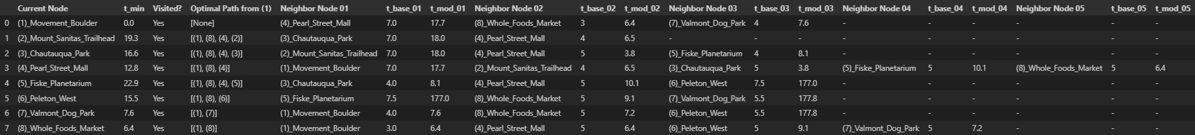
Start
Rush Hour with Uncertainty
Optimal Route from 1 to 3 has changed (24.7 min)
Path 1, 8, 4, 3
Finish
Notes:
-RYAN

Slide 8
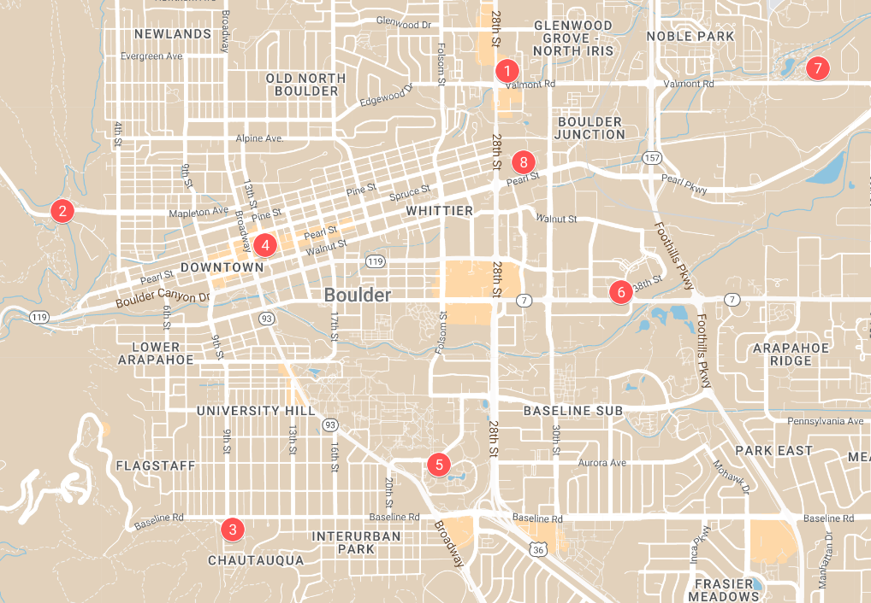
4 min
3 min
5 min
7 min
5.5 min
4 min
5 min
5 min
5 min
7 min
7.5 min
5 min
4 min

Slide 9
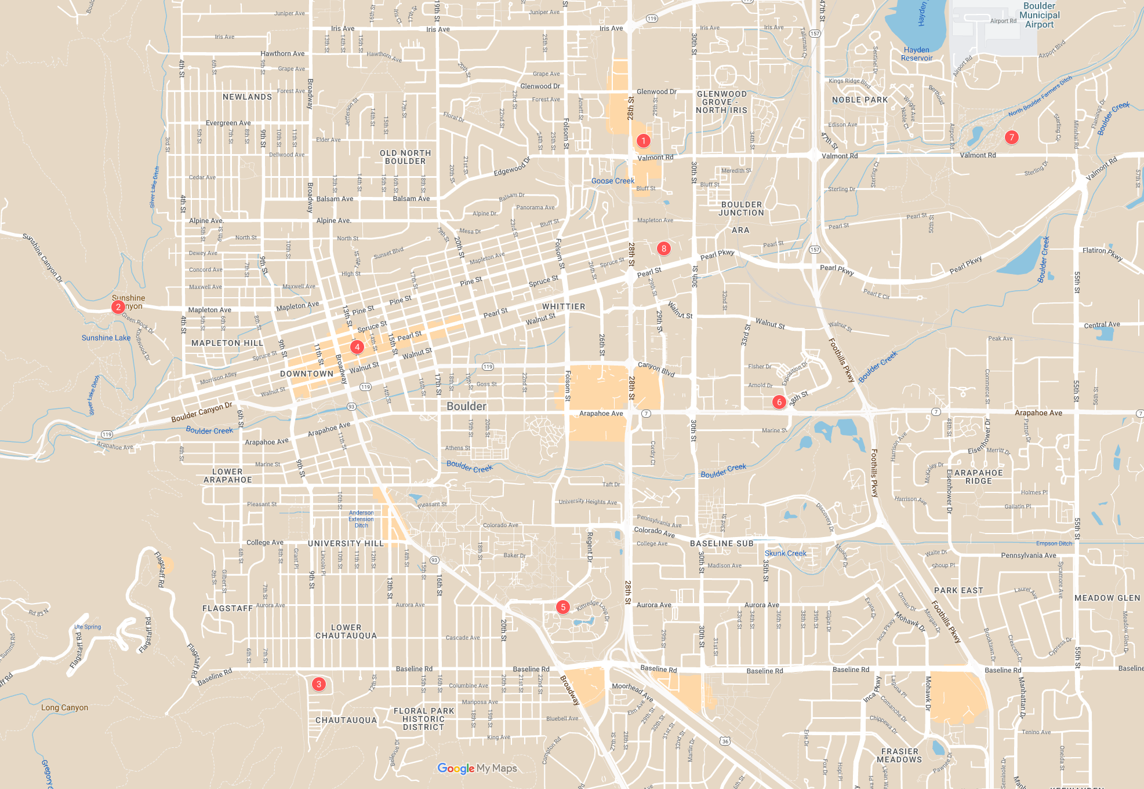

Slide 10
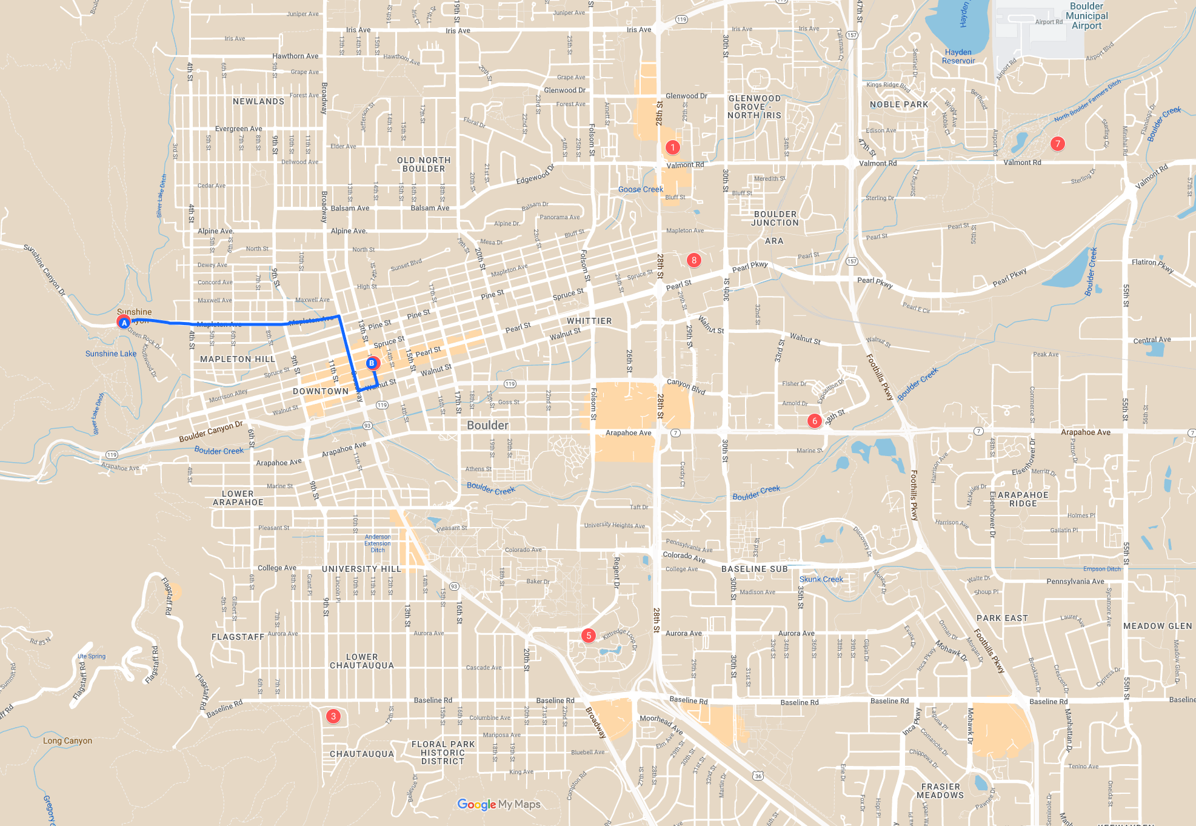
4 min average time

Slide 11
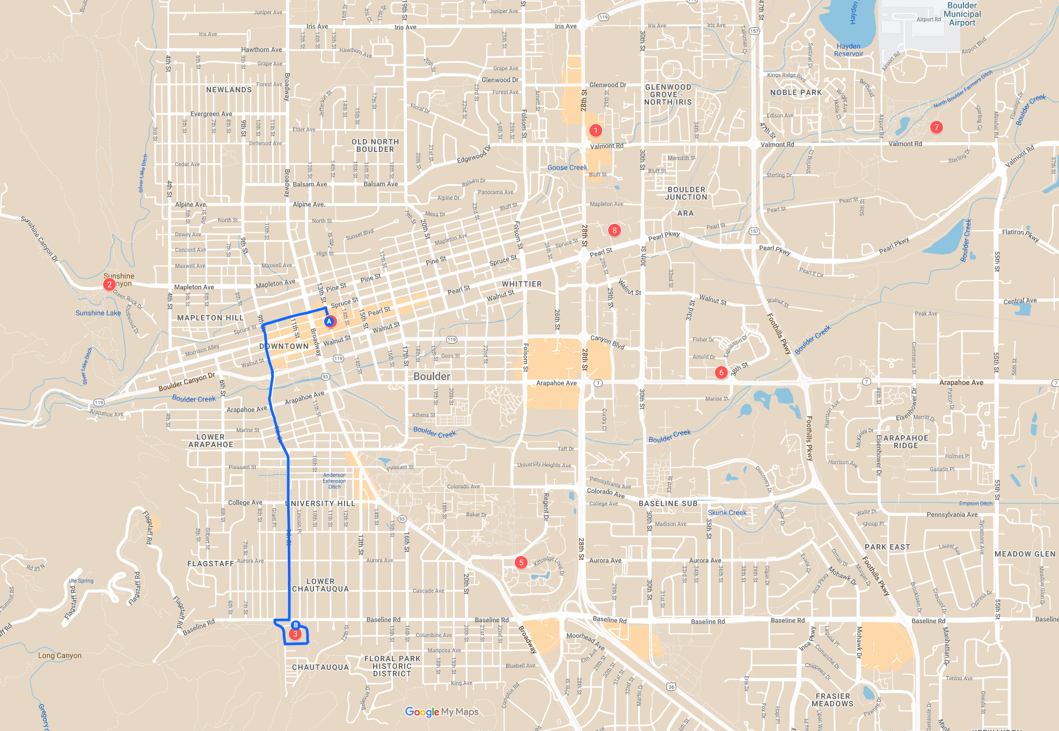
5 min average time

Slide 12
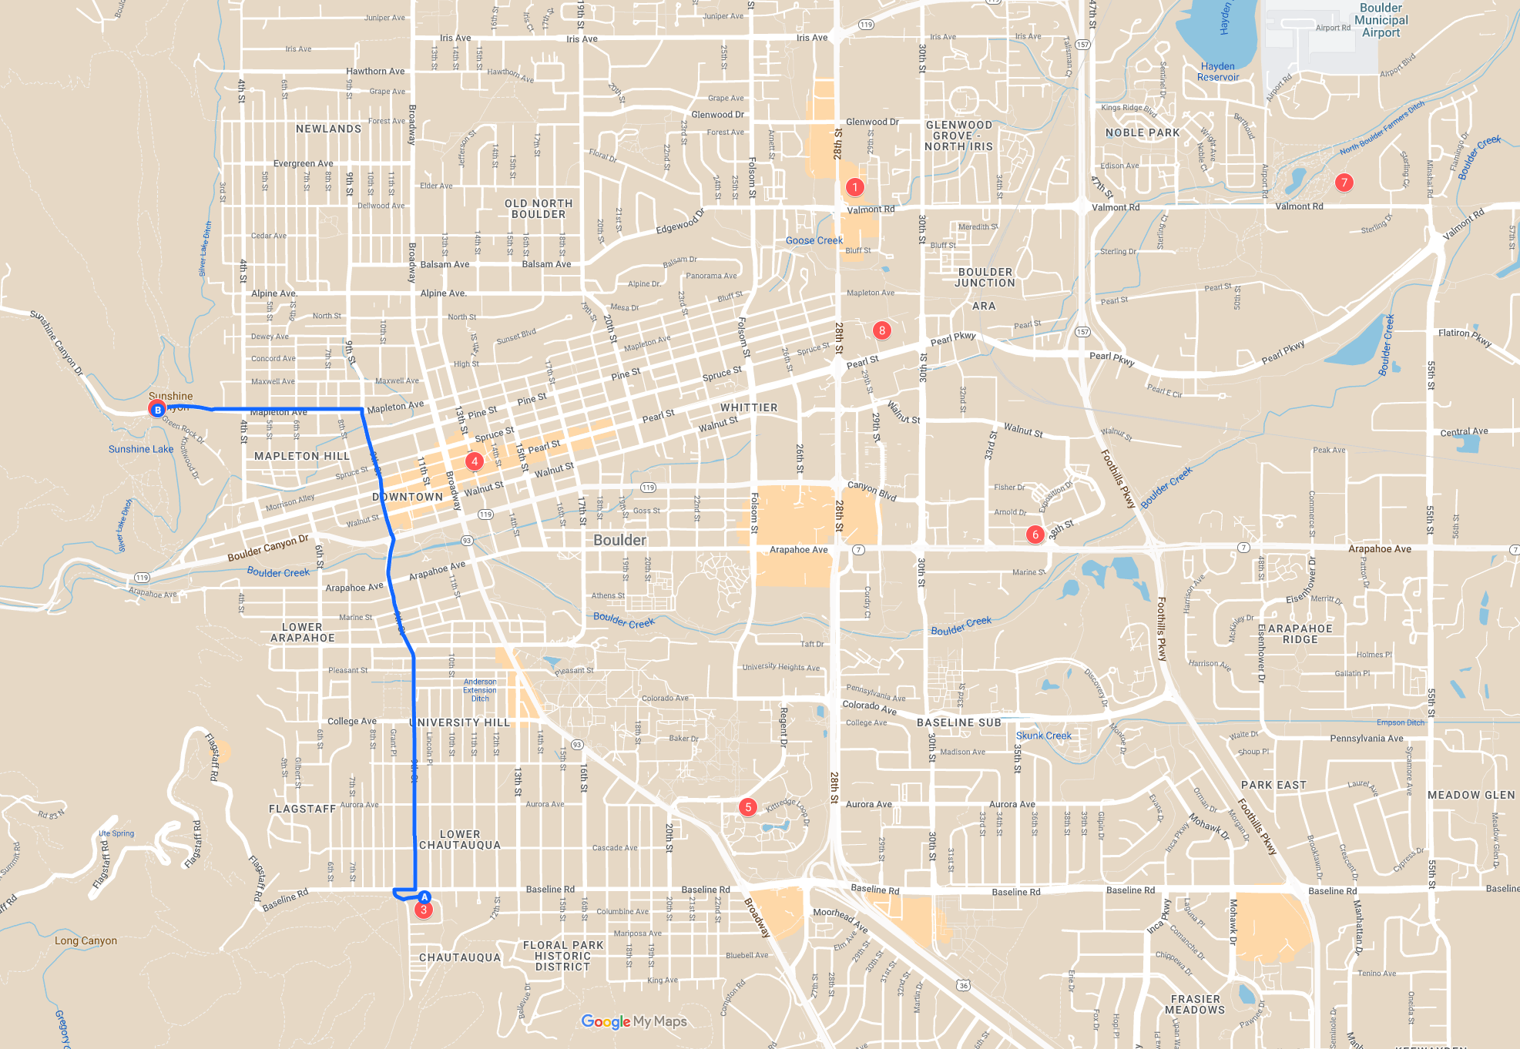
7 min average time

Slide 13
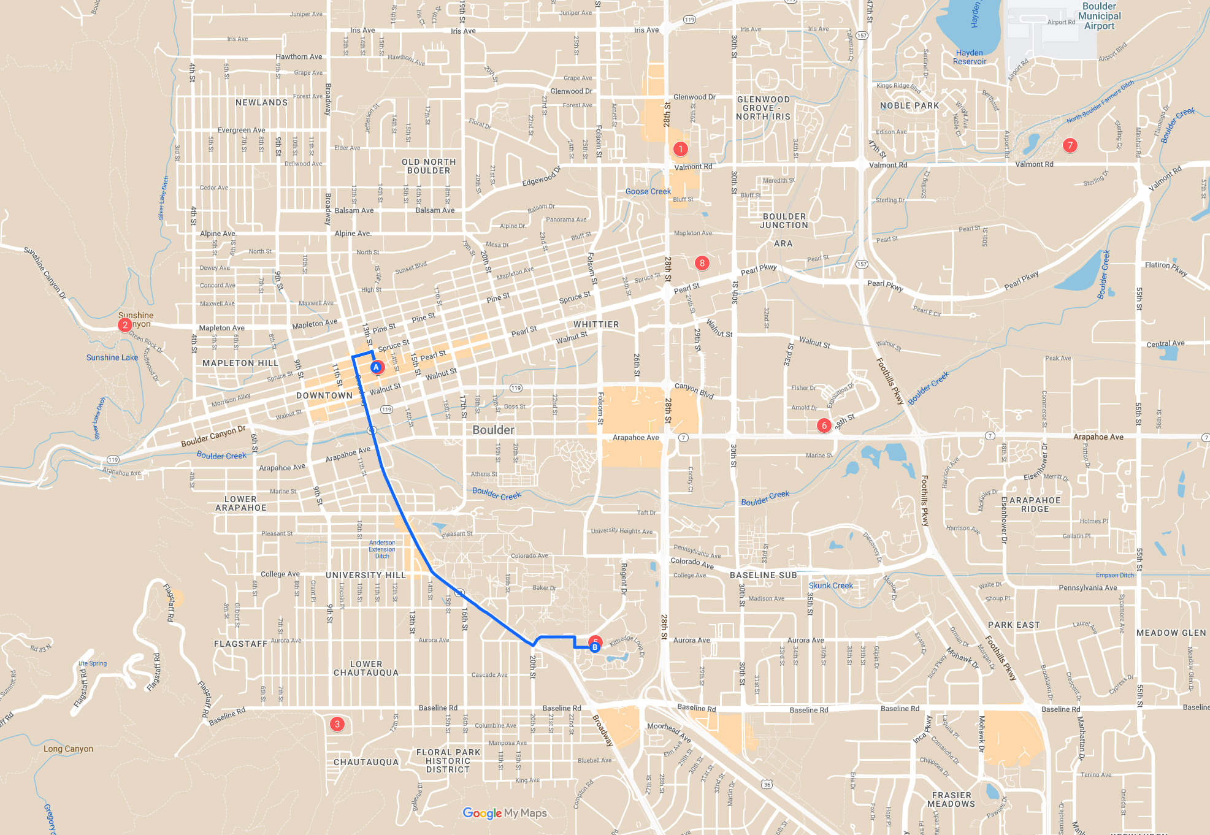
5 min average time

Slide 14
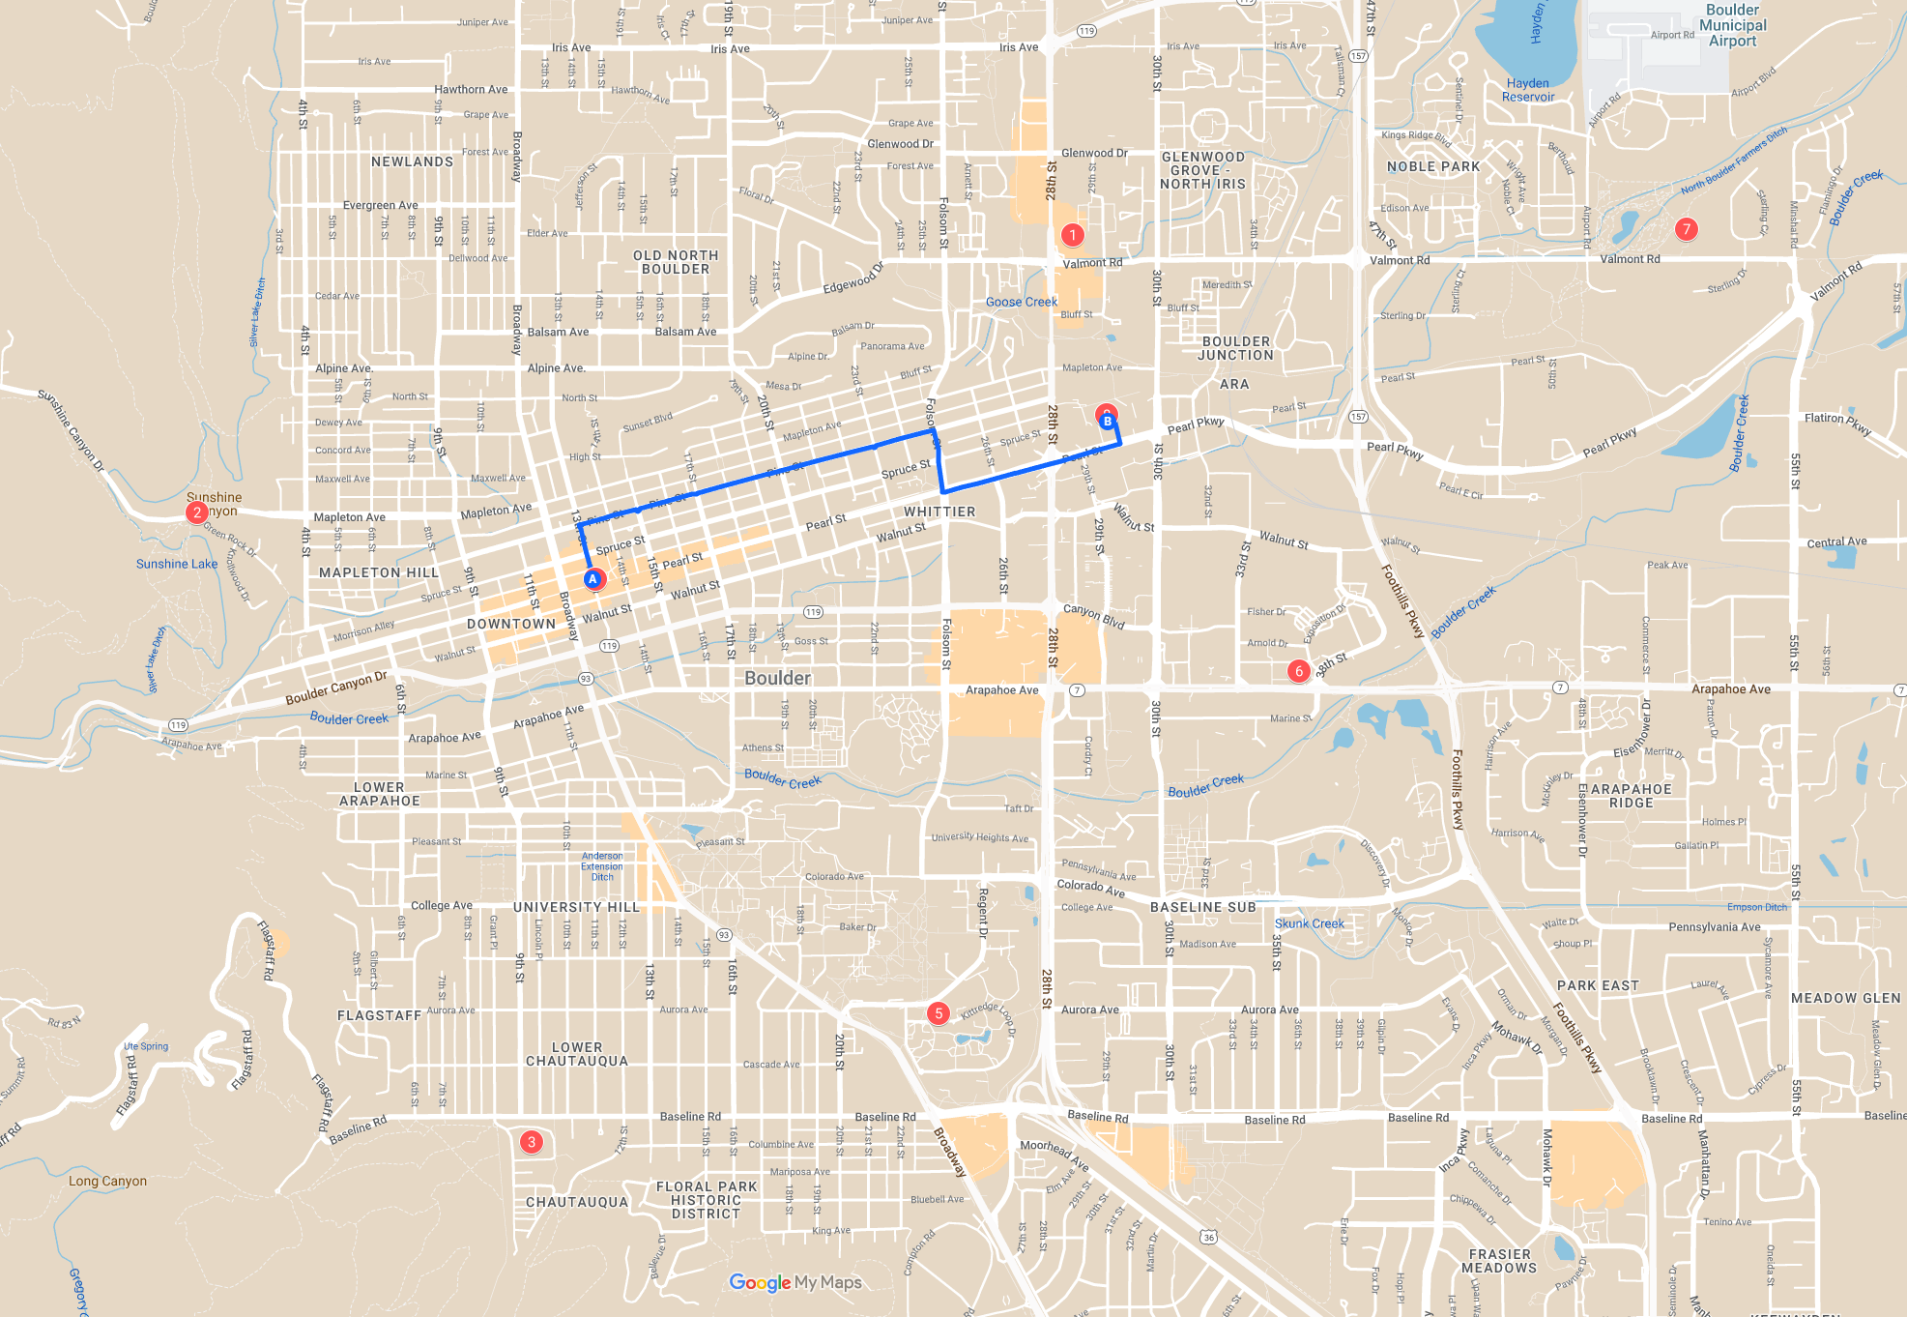
5 min average time

Slide 15
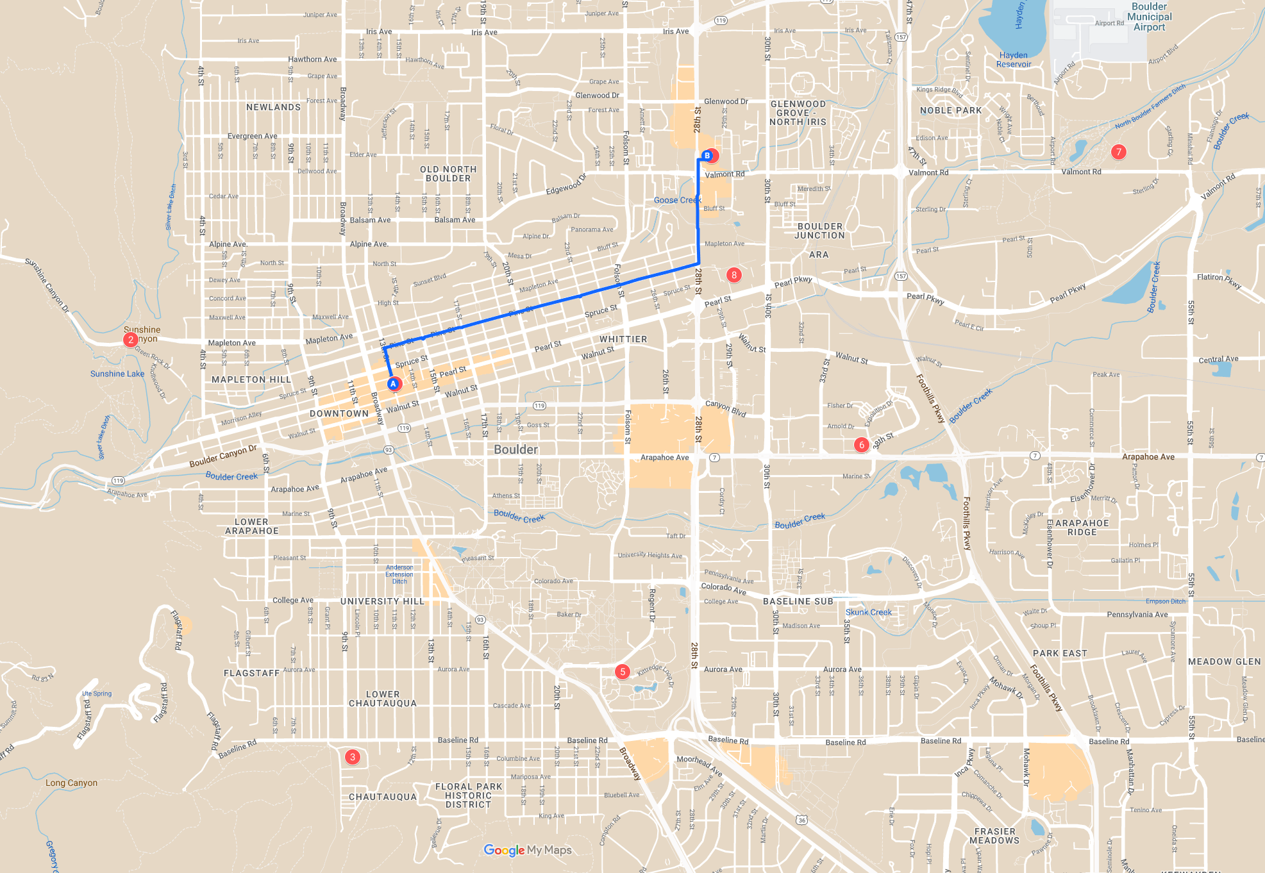
7 min average time

Slide 16
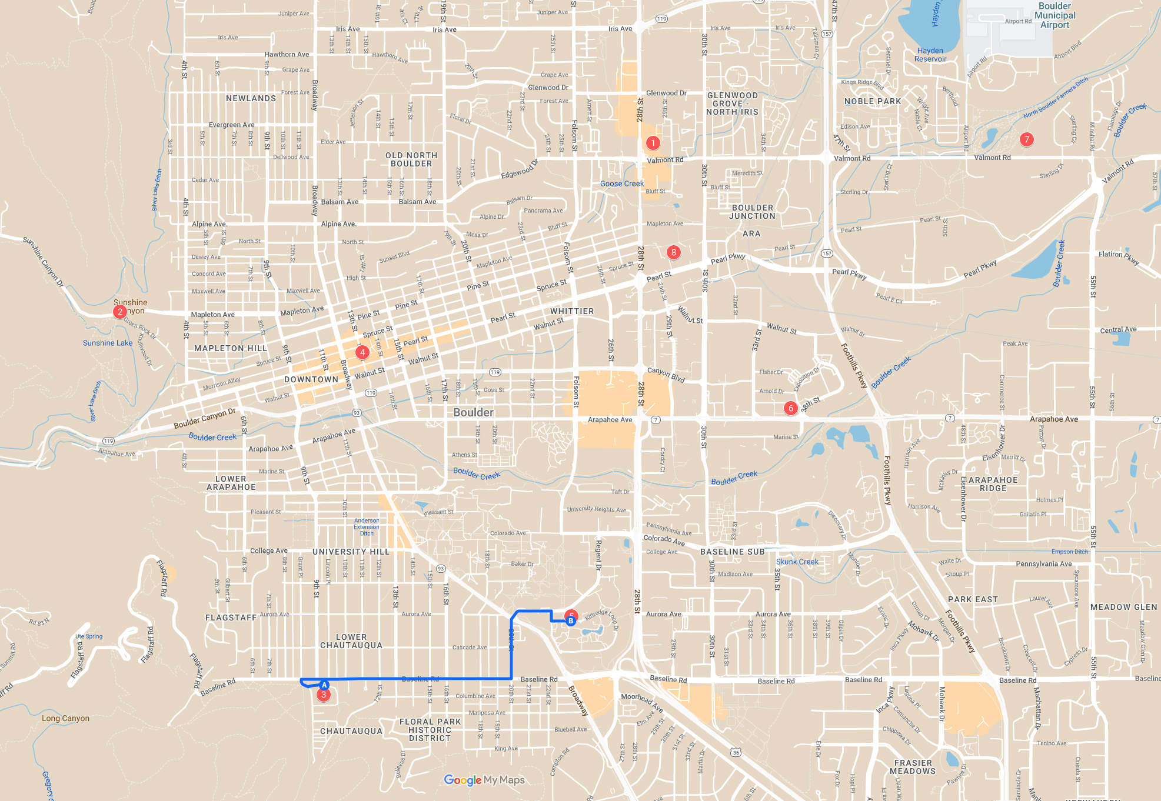
4 min average time

Slide 17
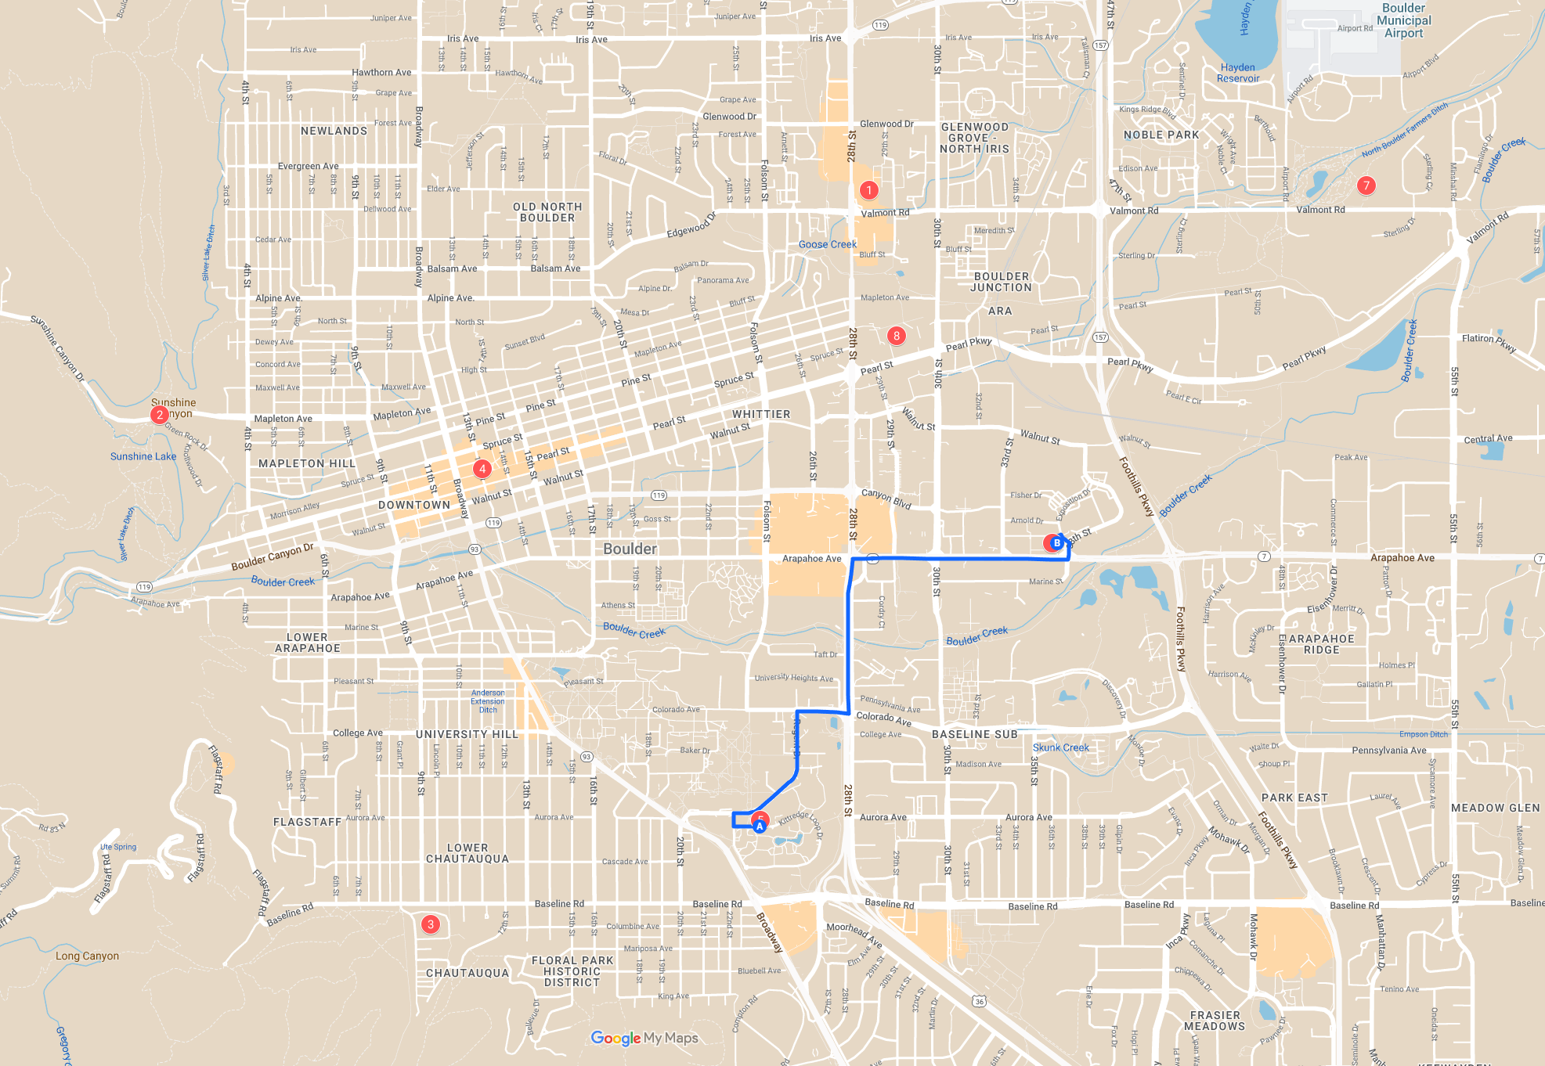
7.5 min average time

Slide 18
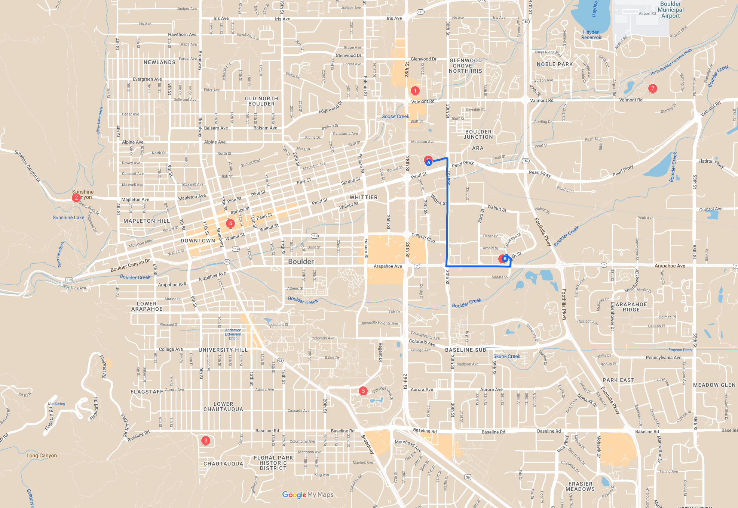
5 min average time

Slide 19
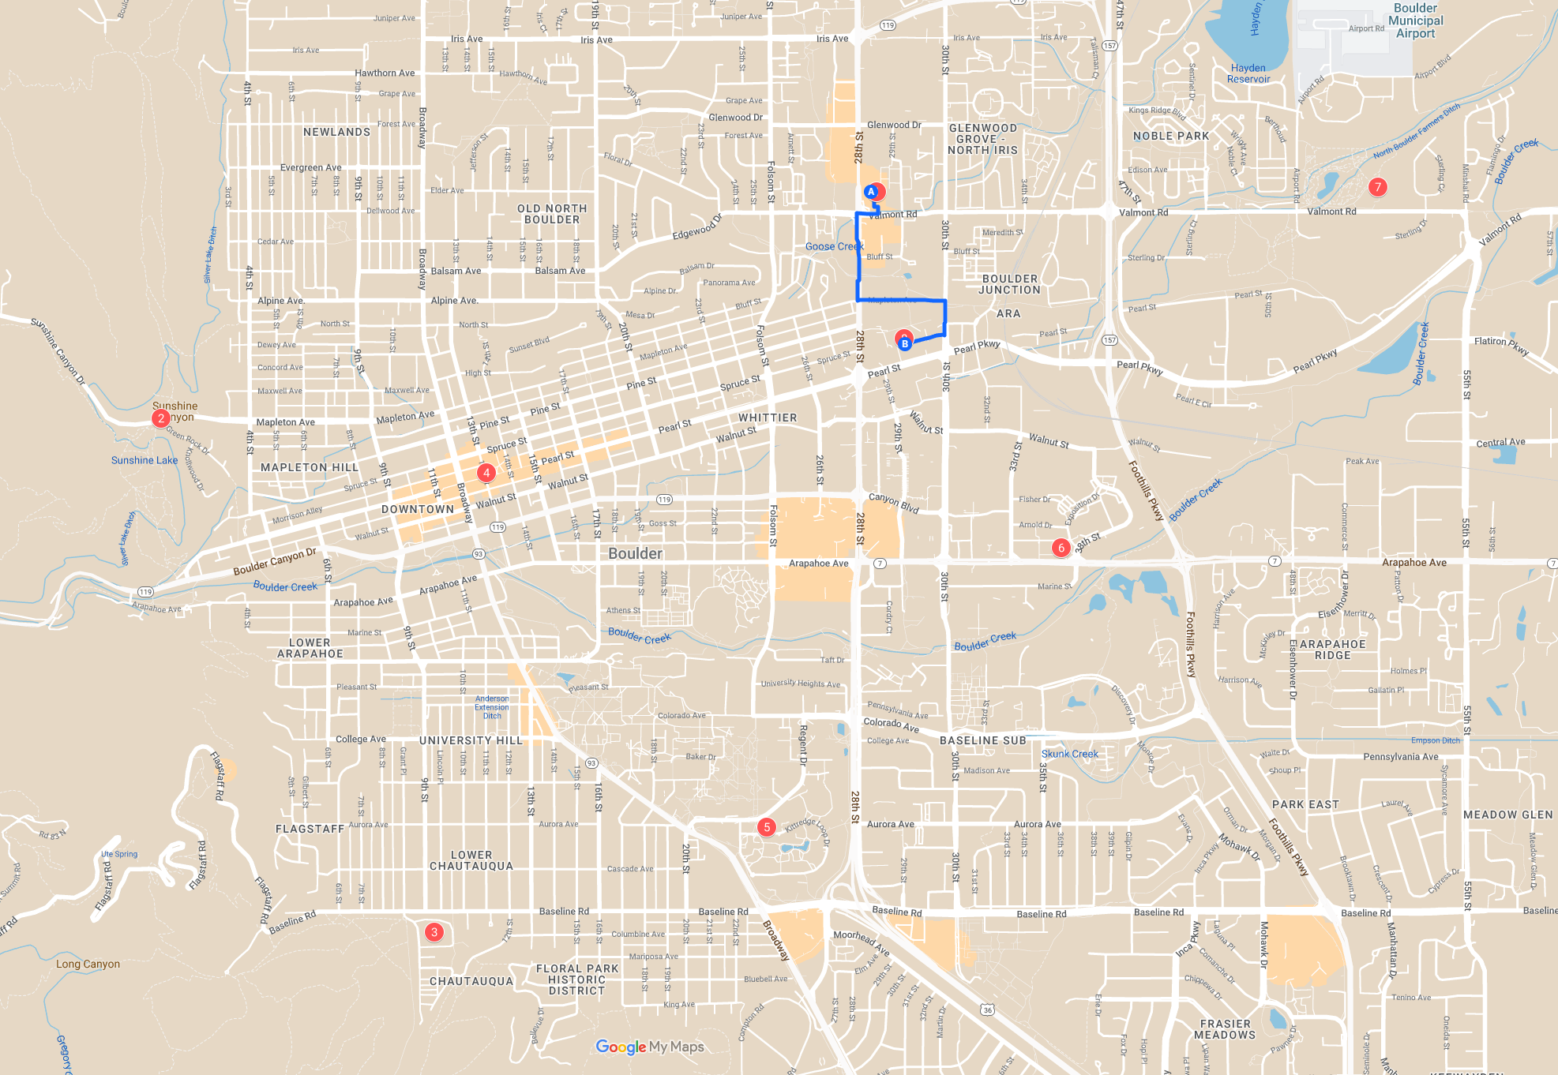
3 min average time

Slide 20
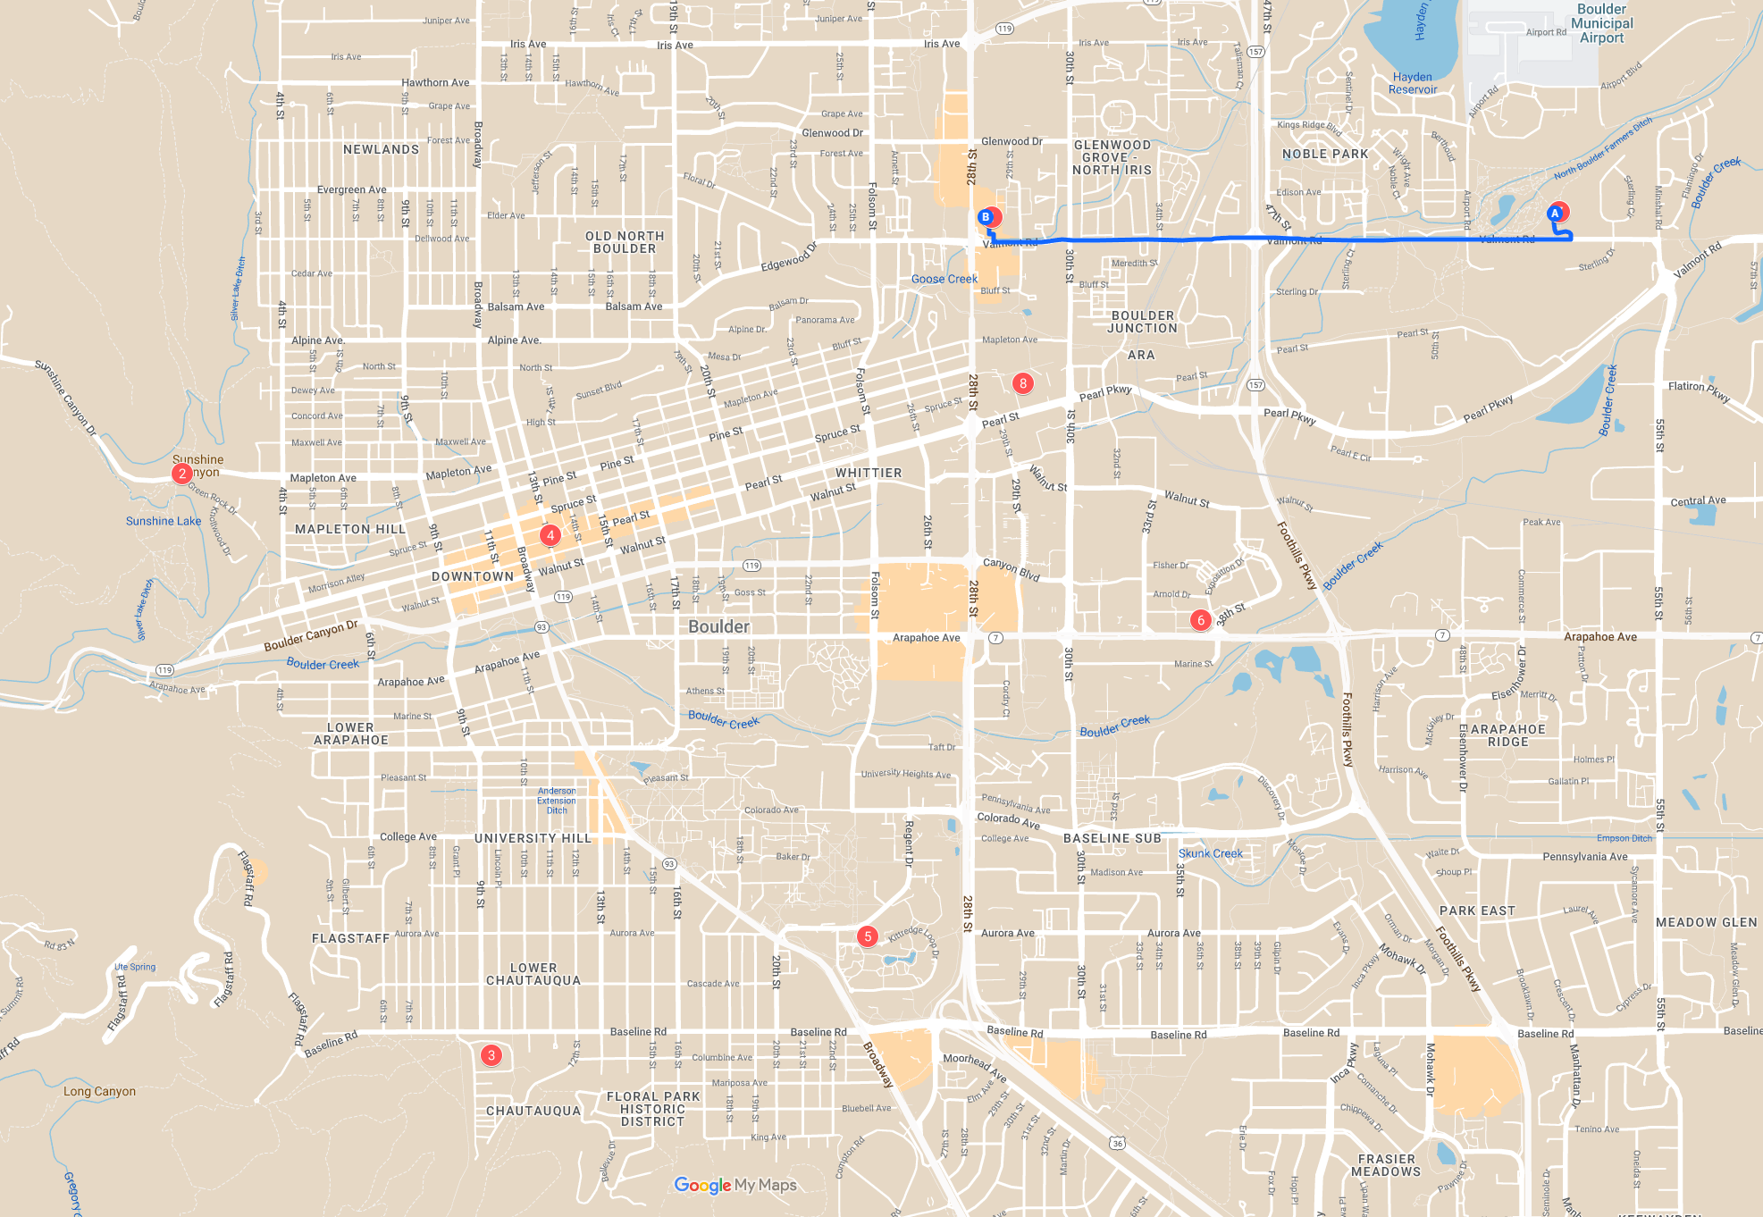
4 min average time

Slide 21
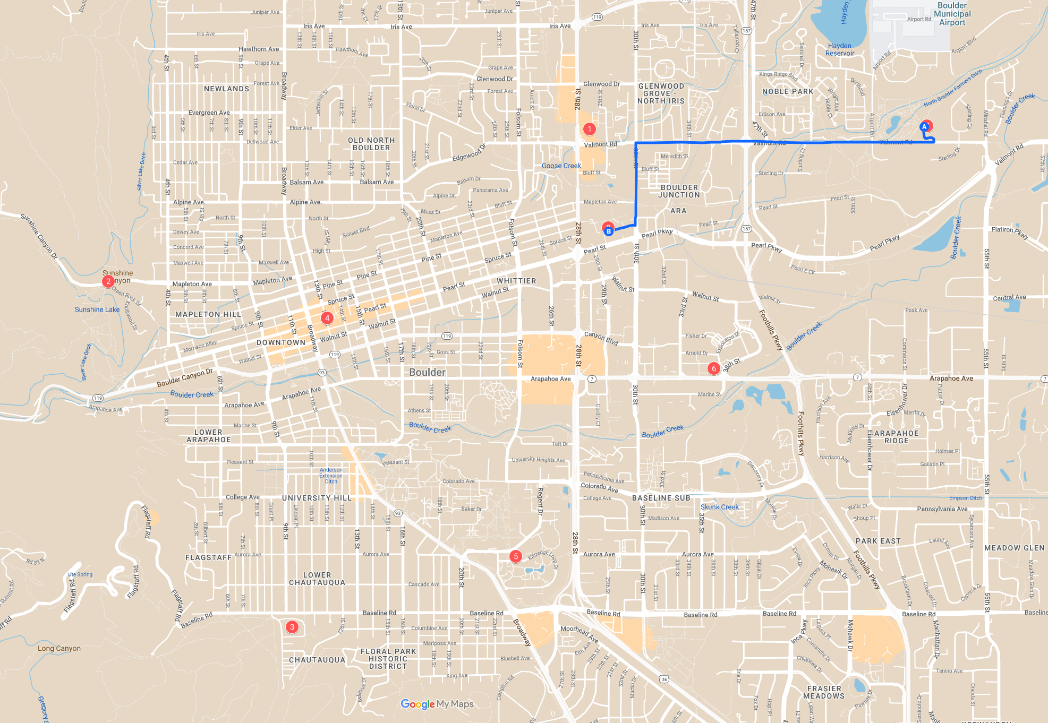
5 min average time

Slide 22
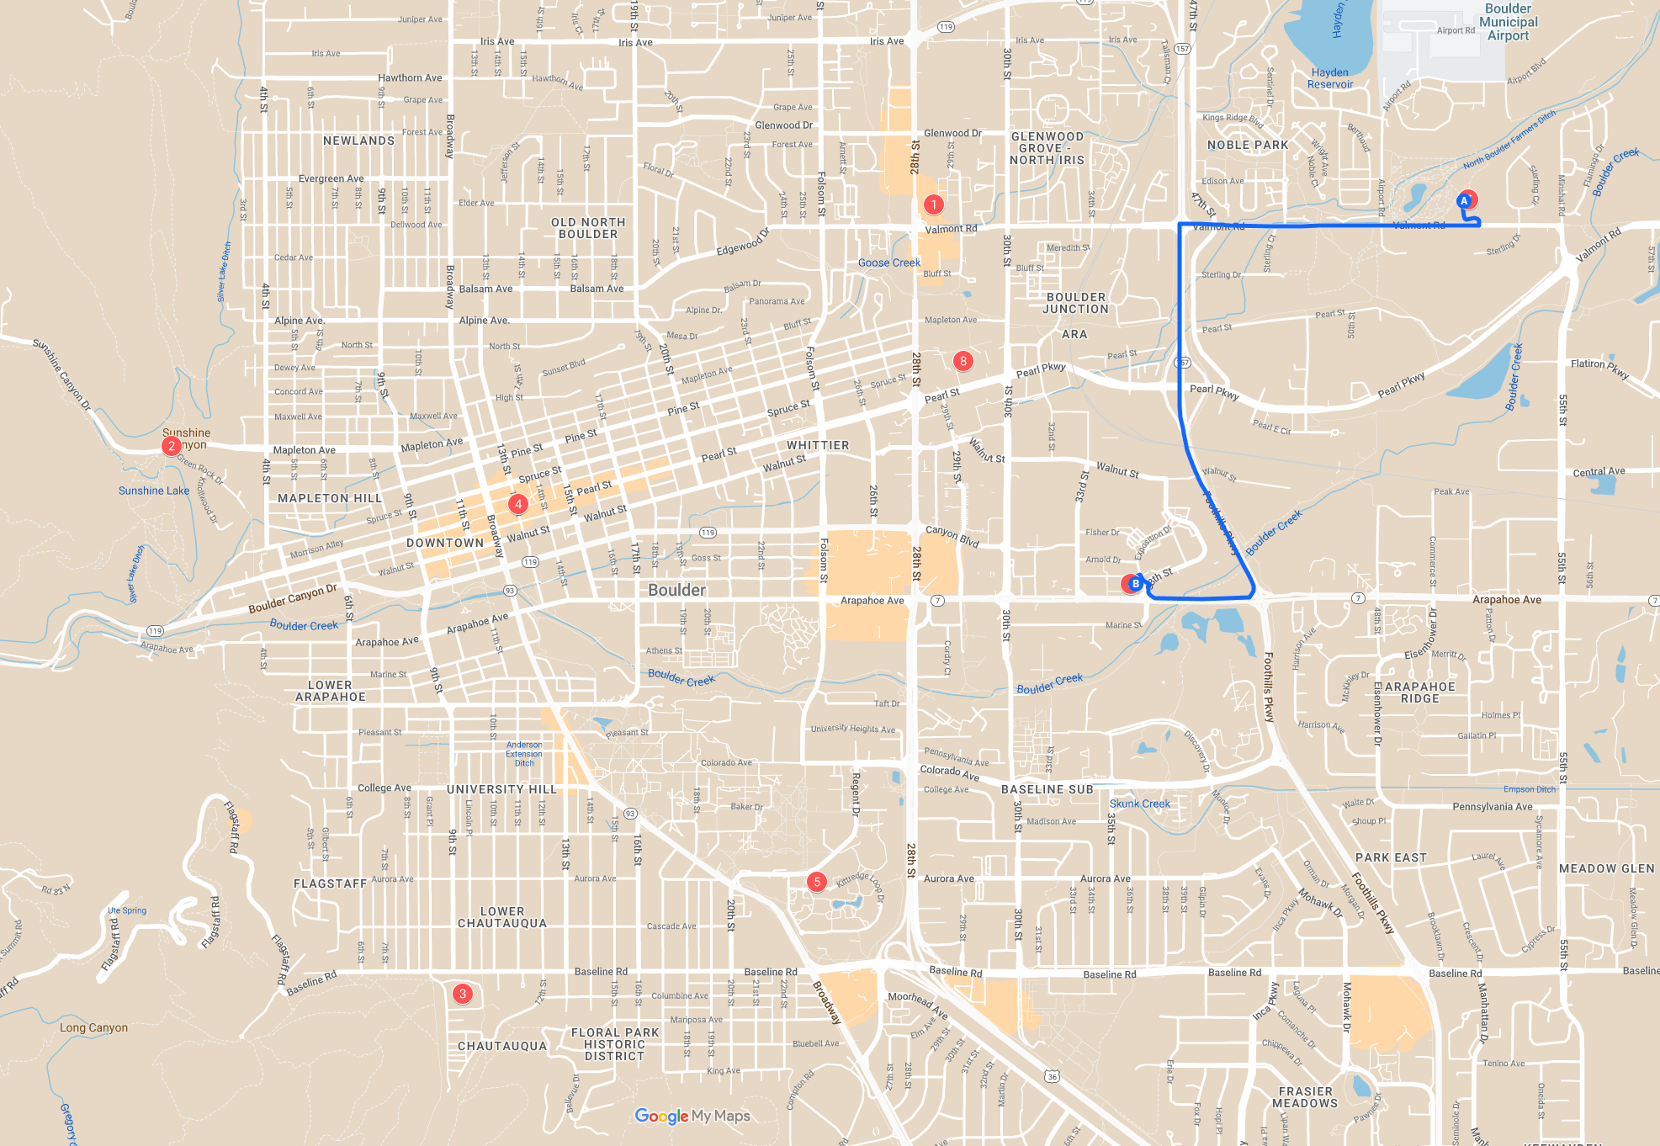
5.5 min average time

